Slide 1

FAKE NEWS DETECTION USING LSTM NEURAL NETWORK
Bots with dots
Swathi Gurijala(C0790294)
Varadharajan Kalyanaraman(C0793756)
Vignesh Kumar Murugananthan(C0793760)

Slide 2
INTRODUCTION
Technological advancements have drastically increased the amount of internet and social media users.
An average user receives information from platforms like Facebook, Twitter, Reddit and Instagram.
There is a high chance that the information is bogus and is specifically crafted to spread wrong information.
Goal : To classify the Fake information using ML.

Slide 3
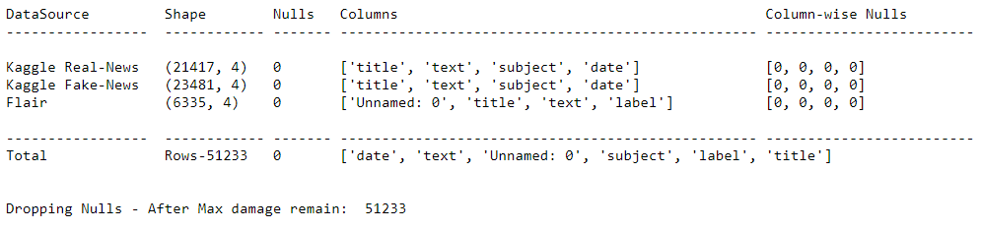
DATA SET
We collected our data from Kaggle and Data flair.
Dataset contains over 50k records.
Out target variable is label which is categorized into FAKE and REAL.

Slide 4
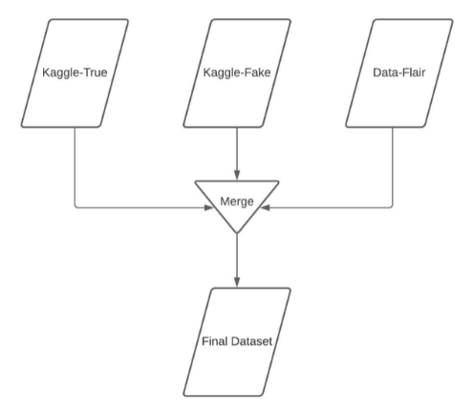
DATA PREPARATION
Merged the Datasets
Handled Missing values
Removed Duplicates
Checked for Data set Uniformity

Slide 5
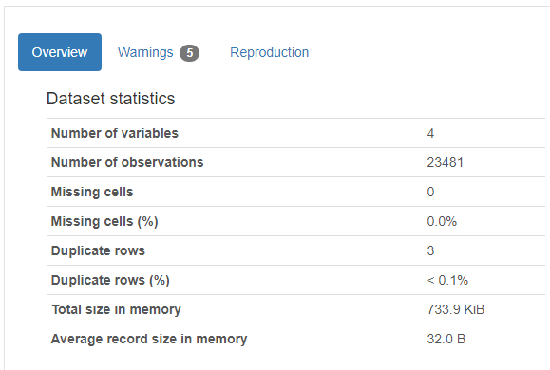
PROFILING REPORT
Provides visualizing and understanding the distribution of each variable
Provides information on:
missing vales
Duplicates
Sample and Overview of the Data Frame.
Pandas Profiling

Slide 6
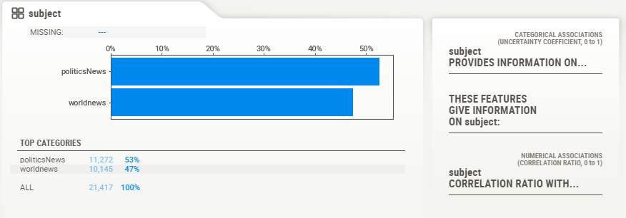
PROFILING REPORT
Sweet viz profiling report to identify trends and patterns in our dataset.
Sweet viz Profiling

Slide 7
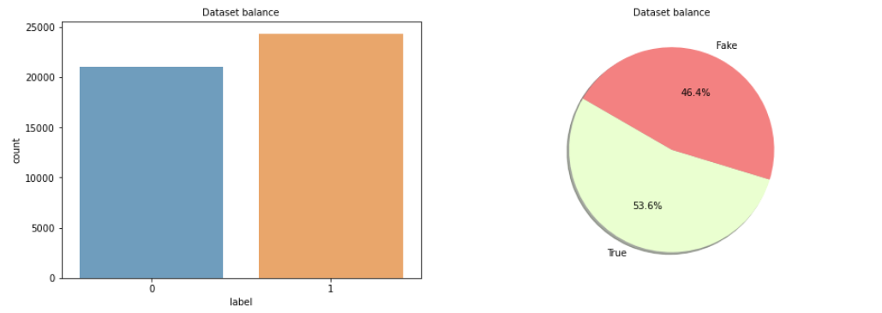
EXPLORATORY DATA ANALYSIS
Data Set Distribution

Slide 8
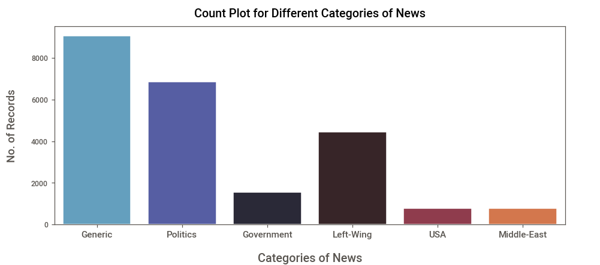
EXPLORATORY DATA ANALYSIS

Slide 9
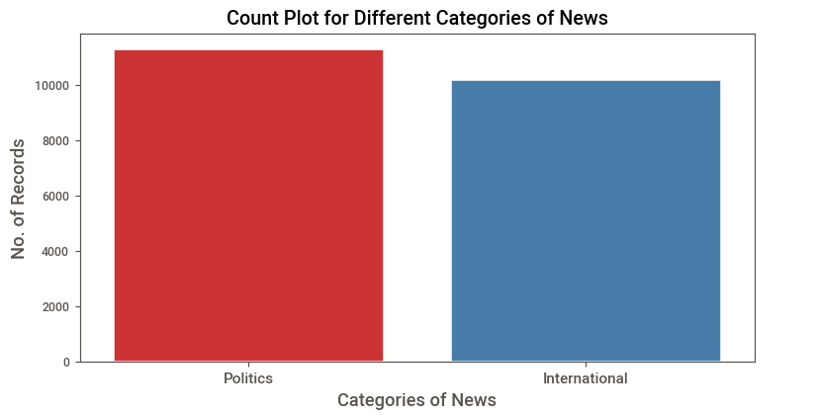
EXPLORATORY DATA ANALYSIS

Slide 10
TEXT PROCESSING
Stemming and Lemmatizing all the comments
Cleaning the comments by removing:
URLs
Contractions
Stop-words
HTML tags
Symbols
Punctuation
Special Characters

Slide 11
DATA MODELING
We have used six models for training our data set.
They are:
SVM
Passive Aggressive Classifier
Random Forest
XG Boost Classifier
Naïve Bayes Classifier
LSTM

Slide 12
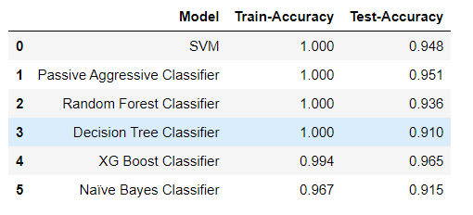
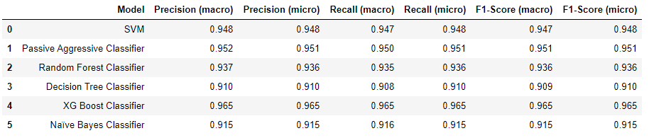
PERFORMANCE MEASURE

Slide 13
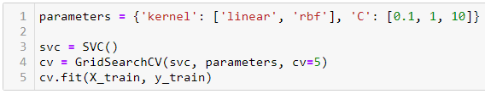

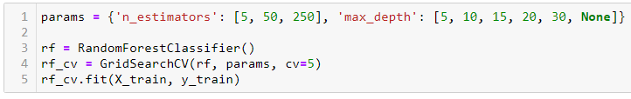
CROSS VALIDATION
SVC
Random Forest

Slide 14
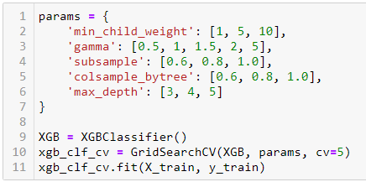
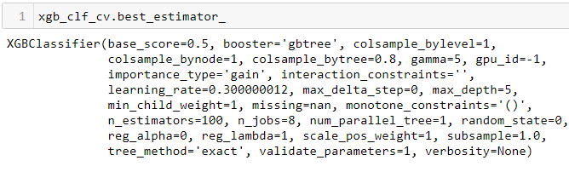
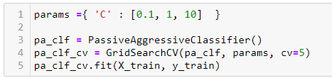

CROSS VALIDATION
Passive Aggressive Classifier
XGB

Slide 15
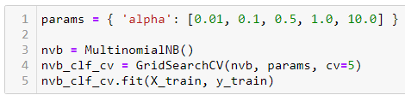

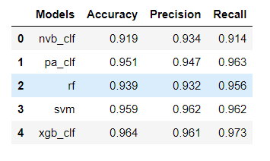
CROSS VALIDATION
Naïve Bayes
Validation

Slide 16
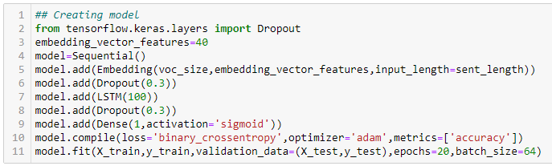

PERFORMANCE MEASURE
LSTM
16

Slide 17
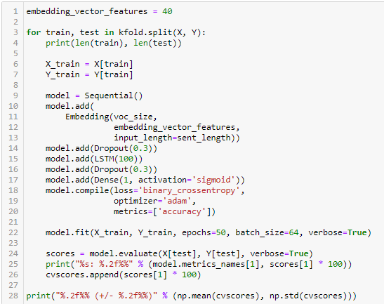
PERFORMANCE MEASURE
LSTM Cross Validation
17

Slide 18
FRONT END – Flask
ReactJS simplifies the overall process of scripting components.
It facilitates advanced maintenance and boosts productivity.
It is a component-based architecture allows quicker rendering and easy state management.

Slide 19
BACKEND – ML Model
ML model
Text processing
Text vectorization
Loading and prediction

Slide 20
CONCLUSION
As RNN’s are known to work well with Text Data and Time series problems statements, we preferred LSTM over XG Boost for classification.
We can further improve the model's performance by training it over a larger datasets and Hyperparameter Tuning.
Our project can help to tackle:
In predicting if given information is genuine or fake
Media house challenges
Information assurance
Mitigate hoax
Attenuate pseudoscientific statements

Slide 21
THANK YOU

